Slide 1
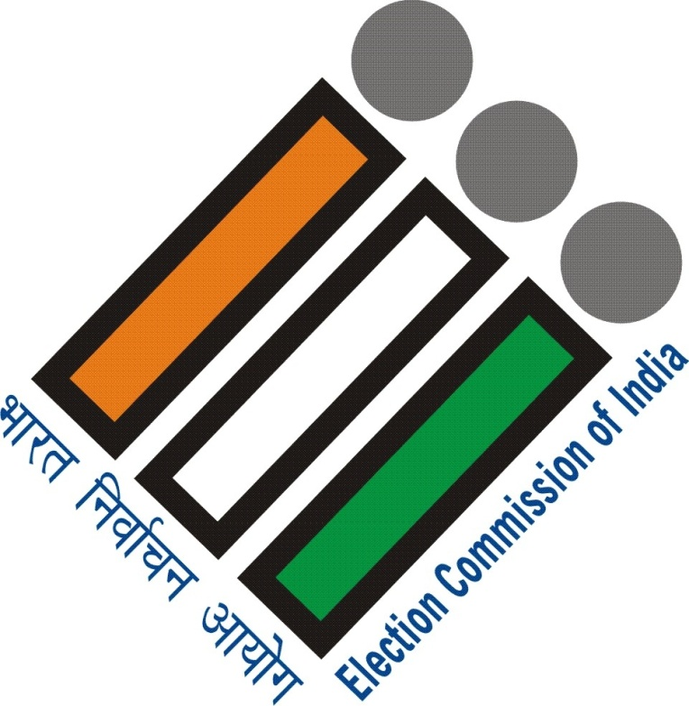
Systematic Voter Education & Electoral Participation Programme
Training for SLMTs

Slide 2
SVEEP Cycles
Pre-Revision SVEEP
Revision SVEEP
Campaign
ELCs
NVD & Conduct of Elections
NVD
H2H Survey
Special Drive including Special Enrolment drives for PWDs
PWD Enrolment
Special Interventions
SVEEP before Announcement of Elections
SVEEP for Loksabha Elections, 2019
Documentation
Documentation

Slide 3
Planning for Lok Sabha Elections, 2019
360 % Media Campaign:
Outdoor, Print, Radio, Television, Interpersonal & Social
State, District and AC level SVEEP Plans
Campaign through Electoral Literacy Clubs (ELCs)
Interventions for PWDs
Plan of action shared with Commission
Special Interventions for the Marginalized
Migrants/ Sex Workers/ Transgender/ Railway Porters/ Senior Citizens in Homes & Overseas Voters
Intensive Monitoring on GIS platforms through a dedicated App & Systematic Documentation
Awareness on EVMs/ VVPATs for
LOK Sabha Elections, 2019
Dissemination Strategies developed & shared with the Commission: coverage of all habitations
Protocol maintained: ECI’s creatives to be followed
Day-to-day Supervision through portal

Slide 4
Voter Education Strategies for Lok Sabha Elections, 2019
Principles:
Visible presence of Election Commission during Campaign
Special Component Plan for Persons with Disabilities
Major focus of Campaign on EVM & VVPAT
Platforms of ELCs for optimal utilization
Utilization of all media including Social Media

Slide 5
Voter Education Strategies for Lok Sabha Elections, 2019
State SVEEP Plan, 2019 will be an organic whole of Strategies developed by Districts
District Plans will comprise AC level Plans developed by AC level Nodal Officers of SVEEP in districts
District & AC level SVEEP Plans will follow a standard template to be shared with districts
The District & AC level SVEEP Plans will be uploaded in the CEO, WB’s portal

Slide 6
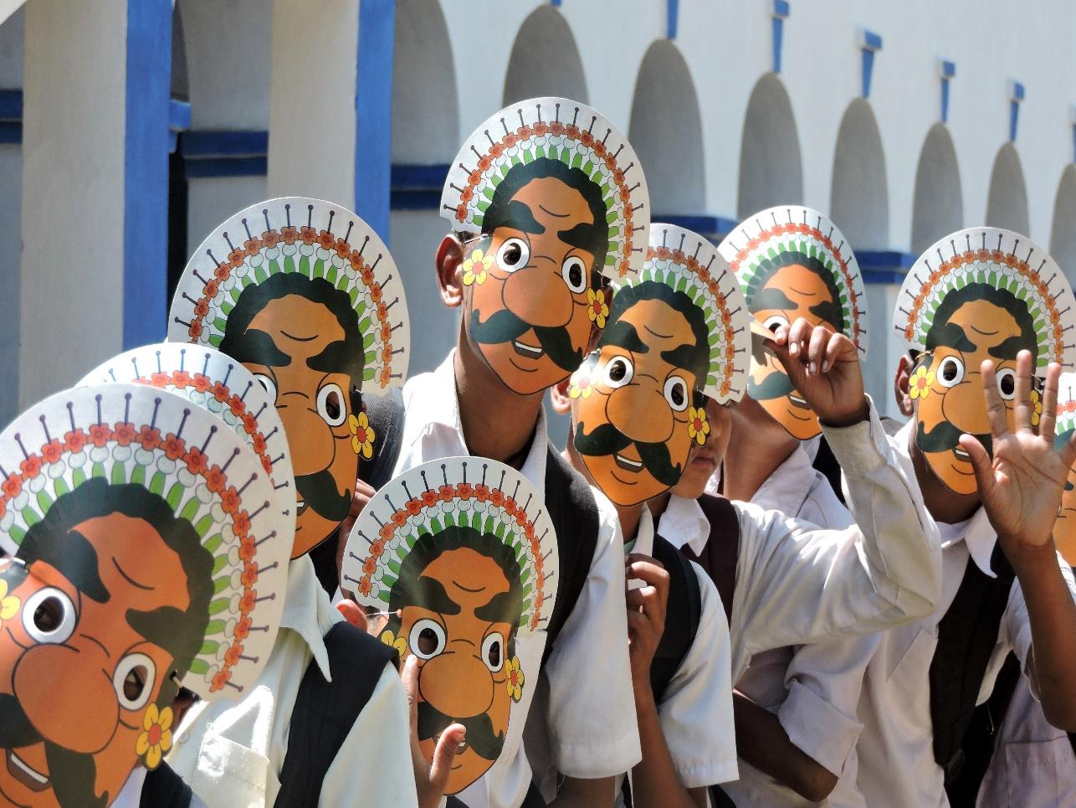
Mapping Objectives for Lok Sabha Elections, 2019
Awareness of EVM/VVPAT
Increasing Turn-Out of Voters
Women Voters
PWD Voters
Young Voters
Service & Overseas Voters
Informed, Ethical and Inducement free Voting
Special Interventions for inclusive voting:
Migrants & other left-out electors

Slide 7
SVEEP Strategy for Lok Sabha Elections, 2019
Planning:
Situation Analysis
Preparing State-district-AC level SVEEP Plan
Activity Mapping
Budgeting
Organizing & Training:
ADM ( SVEEP)
District SVEEP Nodal Officer
AC level SVEEP Nodal Officer
Content Creation:
State level
District/ Sub-district level

Slide 8
SVEEP Strategies for Lok Sabha Elections, 2019
Communication Strategies at State level:
Media Exposure to ensure visibility
Partnerships with State Govt. Departments
Partnership with Corporations/PSUs
Campaign in Doordarshan/All India Radio
Campaign in Radios/Televisions
Campaign in Railways
Campaign in Social Media
Communication Strategies in Districts :
Exposure through Outdoor Media: Enhance visibility
EVM-VVPAT dissemination Strategies
Campaign through ELCs
Campaign in Social Media
Interpersonal Communication
Mass Mobilizations
AC specific Strategies to enhance turn-out

Slide 9
MAJOR VEHICLEs OF DISTRICT CAMPAIGN
Massive outdoor campaign by taking control of major hoarding sites of I & CA department
Using local cable channels for widespread information sharing
Campaign through SHGs & AWWs
Using local folk performers
Street Plays
Public Announcements and distribution of leaflets
Local level Innovations

Slide 10
SVEEP Strategies for Lok Sabha Elections, 2019
Partnership at State level:
With I&CA Department
With Kolkata Police
With Kolkata Municipal Corporation
With Kolkata Metro, Railways
With Calcutta Tramways (CTC) and other transport providers
With WCD, School Education, Higher Education, Food & Supplies, Youth Affairs, P&RD Departments
AIR, DD
BSNL
Private Mobile Networks
Banks
DAVP, NSS, NYK
We have to explore new avenues of partnership with Government & Non-Government Sectors
District level partnerships with PSU Banks

Slide 11
Implementing Pre-Announcement SVEEP Strategies
Finalize AC, District & State Plans for LokSabha Elections, 2019
Complete Engagement of Officers wherever there are vacancies
Complete training/orientation of Stakeholders
Additional District Magistrate in charge of SVEEP
District SVEEP NODAL Officers
AC level Nodal Officers
Media Representatives
Representatives of recognized political parties
Celebrating National Voters’ Day, 2019
Build Up of spirit of participation through ELC activities
EVM/VVPAT demonstration in offices and institutions

Slide 12
Implementing Post -Announcement SVEEP Strategies
MEDIA EXPOSURE : Outdoor/Electronic/Social/Interpersonal
Campaign will roll out right from the date of announcement of elections
OUTREACH: Sector Officers/ BLOs/ SHGs/CSOs
OUTREACH through ELCs : as per Roll Out plan of ELCs
OUTREACH for EVMs/VVPATs: Demonstration in habitations
OUTREACH for PWDs: Reaching out category-wise to PWD voters

Slide 13
EVM-VVPAT Awareness
Dissemination Strategies
State & District

Slide 14
State level Plan
Media Campaign:
Outreach through Electronic Media/Radio FMs on a sustained basis
Continuous Campaign in assigned slots in Doordarshan in Bengali & Nepali
Continuous Campaign in assigned slots in AIR in Bengali/Nepali/Santhali
Advertisements in Newspapers
Extensive Campaign in Social Media: Facebook & WhatsApp: Video
Talk Shows in televisions and Radio FMs
Campaign through Cinema Halls ( PVR & IONOX )
Campaign through Cable television networks
Media Strategy:
CEO, WB’s Press Conference followed with exposure to EVMs/VVPATs with all national & State level media houses showing hands on EVM & VVPAT demonstrations

Slide 15
State level Plan
Interaction with representatives of State level political parties:
Hands on EVM & VVPAT demonstration Session with State level of Political Parties
Permanent EVM Sensitization & Hands on Experience Centre
at a prominent location in the City
Utilizing Voter Awareness Forums:
Live demo of EVMs / VVPATs
Central & State Government Departments
Central & State PSUs
Banks
Chambers of Commerce
Universities

Slide 16
District Plan
Media Campaign:
Outreach through local Cable television networks: DEOs’ A-V appeal & Scrolls
Talk shows in local television channels
Extensive Campaign through DEOs’ Facebook page & whatsapp accounts
Campaign in all major Railway Stations & airports: video & narrative scroll of messages & announcements
Advertisements in local Newspapers
Interpersonal Communication through SOs/BLOs
Permanent EVM Sensitization & Hands on Experience Centre
District headquarters/ Sub-Divisional headquarters/ Block Headquarters
Orientation Plan for all stakeholders in a systematic manner

Slide 17
District Plan
Campaign through ELCs:
An extensive Campaign will be taken up in districts by organizing Special sessions on EVMs & VVAPTS in all Colleges & High Schools
Interaction with Political Parties:
Hands on EVM & VVPAT demonstration to political parties at district/ sub-division/ Block/ Gram Panchayat levels
District level Media Strategy:
EVM/VVPAT demonstration to district level media representatives
Periodic interaction with media representatives on EVM/VVPATs

Slide 18
Polling Station level Plan
Polling Station level Plan:
Plan for coverage of all habitations in Polling Stations
Day-wise monitoring of awareness drives in Polling Stations
Reporting in Portal with photographs

Slide 19
Enabling Voters Making elections accessible

Slide 20
Who are persons with disabilities?
Persons with disabilities include those who have long-term physical, mental, intellectual or sensory impairments which in interaction with various barriers may hinder their full and effective participation in society on an equal basis with others.
United Nations Convention on the Rights of Persons with Disabilities

Slide 21
Strategies for Inclusion of Persons with Disabilities ( PWDs)
Appointment of State ICON
Campaign material tailor made for PWDs
outdoor, audio-visual and audio spots
Web Tutorial for PWDs: In Bengali & English
Focus on Home Registration: Call 1950, We will Reach You
Special Drive during Pre-Revision & Revision programmes
100% Inclusion of identified Eligible PWDs during House-to-House Survey & Summary Revision programme
Registration of eligible PWDs in PWD ELCs
Accessible Communication material in ELCs, Hospitals, Care Homes & other institutions
Welcome you to the Journey on
Elections & Electoral Registration
Now Available in Google Play Store
Anubhab: the PWD Apps

Slide 22
Strategies for Accessible Elections
Areas of Interventions
Training & Sensitization
Campaign & Mainstreaming
Poll Day Interventions
Facilitation

Slide 23
Strategies for Accessible Elections
Facilitation
Training & Sensitization
Facilitation before Poll
Wide Use of ANUBHAV, the PWD app
Dedicated Helpline for PWD Voters
Braille PVS: Priority Voter Marking
Enlarged Information Sheet with information on Polling Station locations, candidates
Facilitation on Poll Day
Signage in Braille on Voting Procedure
Booth Sahayak
Magnifying Glass with light
Transport facilities for PWDs who opt for it
Development of training Module for election officials on PWD Voters
Sensitization of PP about the measures of facilitation available at Polling Station for PWDs
Code of Conduct for PPs on PWD Voters: DOs & Do nots
Advisory to Political Parties to make campaign material accessible

Slide 24
Strategies for Accessible Elections Campaign & Mainstreaming
Door-to-Door Campaign: Category wise sensitization of PWD Voters
Awareness on EVMs & VVPATs
Mass Mobilizing Initiatives: Campaign by State & District Icons
Campaign for PWD Voters by PWDs
Sign language telecasts with closed captioning : web tutorial on how to vote
Development of Campaign material for Radio & television
Development of Campaign material with pictorial images
Auditory Instructions on how to vote
Sensitization of PWD Voters in order that they cast their votes in person Awareness on EVMs & VVPATs
Penetration of PWD Institutes/Care Homes/Hospitals for campaign

Slide 25
Strategies for Accessible Elections Poll Day & Post Poll Interventions
EPIC in Braille Presiding Officers to be given a list of PWD voters of the PS area
Signage from entry to exit including basic minimum facilities for PWD Voters
Magnifying Glass with light
Wheel Chair
Booth Sahayak
Transportation of PWD Voters from residence to Polling Stations
Announcing Results in accessible formats : SMS
Post Election Audit & Survey: Checklist

Slide 26
Special Interventions
Dissemination Strategies
State & District

Slide 27
Targeted Interventions for inclusive elections
Urban Apathy
PwDs and Senior Citizens
Youth
Migrants
Service Voters
Women
Overseas Voters
Marginalised Groups
Transgender

Slide 28
Inclusive Elections: Challenges
Gender gap in turn-Out
Urban apathy in electoral participation
Outreach to Service/Overseas Voters
Special Outreach for Persons with Disabilities (PWDs)
Inclusion of domestic migrants and others

Slide 29
Inclusive Elections: Strategies
Survey of Voters, before Elections, who have migrated outside followed with interpersonal communication to ensure that they remain present on Poll day and vote
Identification of Polling Stations areas where Special categories of Voters exist
Developing special strategies for getting them to enrol and vote
Understanding Reasons of why People do not Vote
Voters not present on Poll day
Urban Disconnect
Sickness/Infirmity
Other reasons

Slide 30
Special Interventions for Women & Youth
Targeted interventions for women participation in Nirbachoni Path Shala
Grass root mobilizations of women by AWWs/SHGs
Folk art and cultural activities specific to women
Young women to be reached through health workers
Enrolment of left-out women during Special drives
Activating ELCs in Colleges & Polling Stations
Conduct of cultural programs in institutions & Polling Stations
Interpersonal communication by BLOs/SOs
Enrolment of the left-out young electors
Special strategies in urban & metropolitan areas

Slide 31
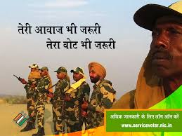
Special Interventions for Service Voters
Special awareness and registration camps for Defence personnel disseminating information on enrolment as General or Service Voter
Training Nodal Officers from defence as Resource Persons for dissemination of information on the entire process of registration and voting
Special campaign for wives of service personnel
Tie up with local AIR and DD on their special broadcasts for Defence personnel to carry message on registration of service personnel

Slide 32
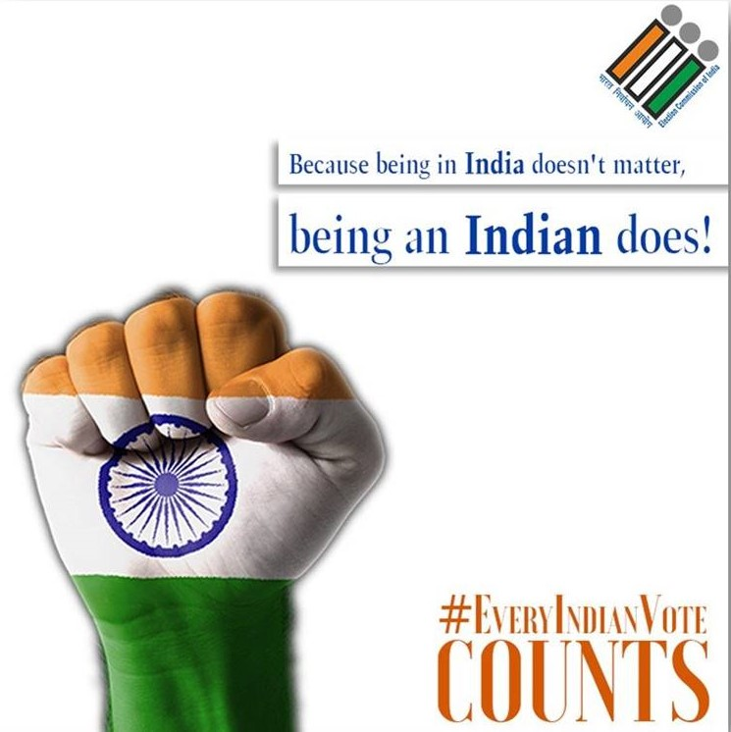
Special Interventions for Overseas Indian Electors
Special Interventions for Overseas Voters
Special appeal from CEO transmitted through e-mail and posts to the overseas electors to come to their homeland and vote
Special Enrolment drive for overseas electors

Slide 33
Special Interventions for Marginalized Groups
Special interventions should be taken up for segments like transgender, sex workers and other groups placed in difficult conditions
Auxiliary polling stations may be envisaged in areas inhabited by commercial sex workers or other categories of voters

Slide 34
ELCs
Plans & Execution

Slide 35
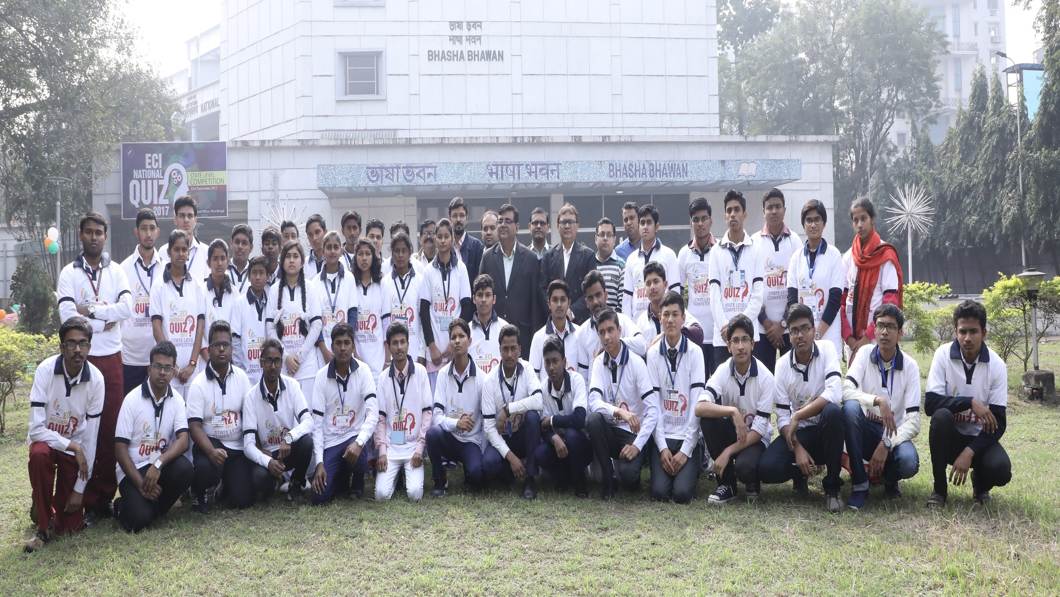
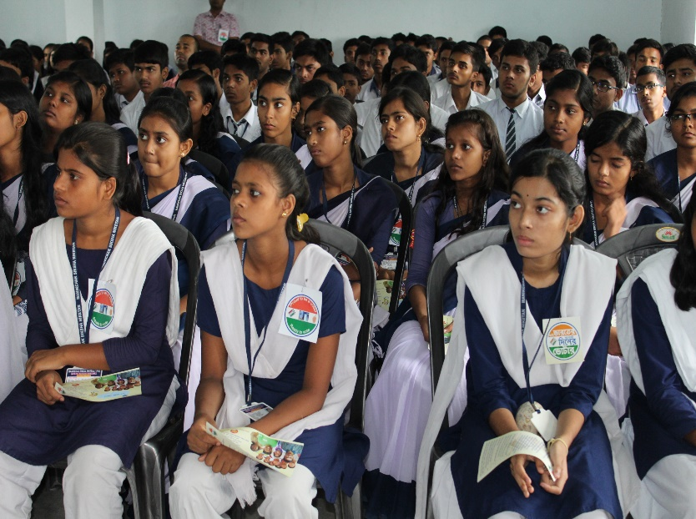
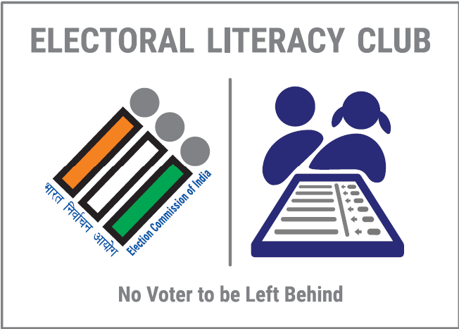
Electoral Literacy Clubs

Slide 36
Voter Awareness Forums in Departments, Private Organizations and Institutions
Electoral Literacy Clubs(New Voter) in colleges and universities
Electoral Literacy Clubs(Community) Chunav Path Shala for those outside formal Education System
Electoral Literacy Clubs (Future Voters) in Secondary & Senior Secondary Schools
Target Audience
Nodal Officer-cum-Convenor will steer activity in ELCs

Slide 37
Electoral Literacy Clubs (ELCs)
Key Features
ELCs for Future Voters: 964, ELCs for Newly Enrolled Electors: 164
Chunao Pathshala in all Polling Premises
CEO’s Club/ DEOs’ Clubs/ SDOs’ Clubs/ BDOs’ Clubs formed in all districts
PWD ELCs: 78 : Resource Materials and Games generated
Lead ELCs under mentorship of CEO/DEOs/EROs/AEROs
Innovations: ELC Mitra App for monitoring ELC activities , ELC Football Tournament, Green Polling Stations Extempore Speech & Quiz Competition among ELCs for Future & Newly Enrolled Electors ELC Blog & Certificate Course for ELC Master Trainers in Alipurduar district

